Slide 1
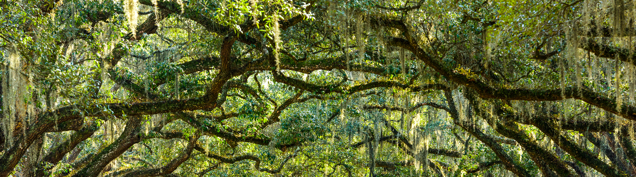
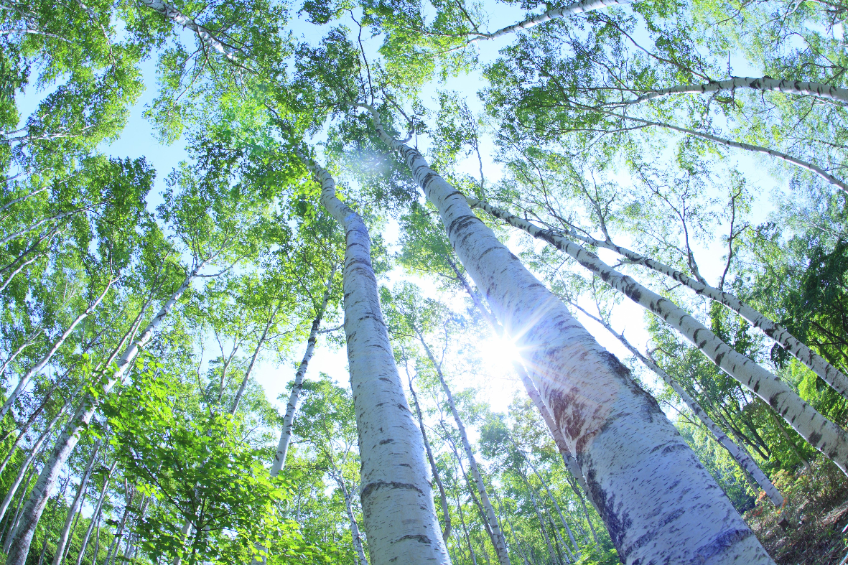
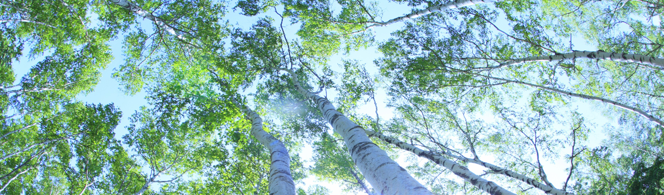
AI Academy Apprenticeship Capstone Tree Coverage
Sage Reagan

Slide 2
Agenda
1
2
3
4
Project Goals Business case
Data Data understanding and preparation
Methods
Proposed team
Result
Our capabilities

Slide 3
Project Goals
Complete a Machine Learning Model for a Business Case

Slide 4
Business Understanding
Apprenticeship capstone – tree coverage
The business case that will be addressed in this capstone.
INUSTRY | Stakeholder | Location
Forest and Land Management | Bureau of Land Management | Roosevelt National Park
PROBLEM | Reasoning | Other considerations
Determine which trees are Lodgepole Pine trees based on the surrounding forest characteristics | Bureau of Land Management wants to thin the forest so trees won’t have to fight for light or water. There is an abundancy of Lodgepole Pine tress and cutting them down would help with the forest’s health as well as selling their lumber would be financially beneficial | The Bureau of Land Management does not want to cut down other types of trees as it will not help with the health of the forest and the lumber is worth less.
Notes:
Client: Bureau of Land Management
Industry: Forest and Land Management Industry
Where: Roosevelt National Park
What: Determine which trees are Lodgepole Pine trees based on the surrounding forest characteristics
Why: Want to thin the forest so trees won’t have to fight for light and water, and have decided there is an abundancy of Lodgepole Pine tress and cutting them down would help with the forest as well their lumber being financially beneficial.
Other considerations: the Bureau of Land Management does not want to cut down other types of trees as it will not help with the health of the forest and the lumber is worth less

Slide 5
Data
Data Understanding and Preparation

Slide 6

Data Understanding
Apprenticeship capstone – tree coverage
Variables that will be used in this capstone.
Target Variable:
Tree Coverage Type
SHADE ON HILLSIDE AT 9AM, 12PM, 3PM
ELEVATION
Hillside shade index at given times (0 – 225 index)
10
1
Elevation in meters
SPECIFIC WILDERNESS AREA
ASPECT
9
2
Aspect in degrees azimuth
Wilderness area (4 different areas – binary representation)
SOIL TYPE
SLOPE
8
3
Slope in degrees
Type of soil (40 different types – binary representation)
DISTANCE TO FIREPOINTS
DISTANCE TO ROADWAYS
Horizontal distance to nearest wildfire ignition point
7
4
Horizontal distance to nearest roadway
VERTICAL DISTANCE TO HYDROLOGY
HORIZONTAL DISTANCE TO HYDROLOGY
Vertical distance to nearest water feature
6
5
Horizontal distance to nearest water feature
Dataset Source:
Notes:
Bigger tree with more endpoints, points coming off it
Spell check

Slide 7

Data Preparation
Apprenticeship capstone – tree coverage
What was done to pre-process the data before inserting it into a machine learning model.
DATA PREPROCESSED
7
TREE TYPES
BINARY CLASSIFICATION
Spruce/Fir (211,840)
Lodgepole Pine (283,301)
Ponderosa Pine (35,754)
Cottonwood/Willow (2,747)
Aspen (9,493)
Douglas-Fir (17,367)
Krummholz (20,510)
Data in original form had a class imbalance
Solution: Combine all types of trees outside Lodgepole Pine
Now only a 2.9% difference
The data was previously preprocessed:
No null values
Categorical values have already been encoded
Notes:
Tags: approach, text

Slide 8
Methods
Decision Tree Model
Notes:
Machine Learning Model: Decision Tree Classifier
Classification Type: Binary Classification
Tools: Python packages and Github
Evaluation metrics: Precision, Recall, Accuracy, F1
Metric Prioritization: It is more important to cut down the correct type of tree while not harming other types of trees, also we do not want to cut down all the Lodgepole Pine trees so if we miss some in the categorization, it wont be as harmful as mis categorizing other types of trees. Therefor, it is more important to have more false negatives than false positives and I will be prioritizing precision over recall.

Slide 9
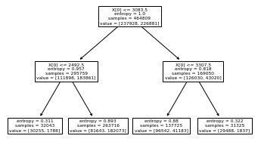
Methodology
Apprenticeship capstone – tree coverage
Classification, tools, and metrics.
Methodology Overview
Decision Tree Classifier Example
Machine Learning Model
Decision Tree Classification
Classification Type
Binary Classification
Tools Used
Python Packages
GitHub
Notes:
Machine Learning Model: Decision Tree Classifier
Classification Type: Binary Classification
Tools: Python packages and Github
Evaluation metrics: Precision, Recall, Accuracy, F1
Metric Prioritization: It is more important to cut down the correct type of tree while not harming other types of trees, also we do not want to cut down all the Lodgepole Pine trees so if we miss some in the categorization, it wont be as harmful as mis categorizing other types of trees. Therefor, it is more important to have more false negatives than false positives and I will be prioritizing precision over recall.

Slide 10




Evaluation Metrics
Apprenticeship capstone – tree coverage
Classification, tools, and metrics.
Metric
Precision
Recall
Accuracy
F1
Precision =
$$\frac{Number of True Positives}{Number of Predicted Positives}$$
Recall =
$$\frac{Number of True Positives}{Number of Actual Total Positives}$$
Accuracy =
$$\frac{Number of True Positives \& True Negatives}{Number of Actual Total Positives}$$
F1 =
$$2×\frac{Recall ×Precision}{Recall+Precision}$$
Explanation
Metric Prioritization
Do not want to cut down all Lodgepole Pine trees
Important to cut down correct type of tree while not harming other types of trees
Lodgepole Pine lumber worth more than other types of lumber
Better to have false negatives than false positives
Prioritize precision over recall
Notes:
Machine Learning Model: Decision Tree Classifier
Classification Type: Binary Classification
Tools: Python packages and Github
Evaluation metrics: Precision, Recall, Accuracy, F1
Metric Prioritization: It is more important to cut down the correct type of tree while not harming other types of trees, also we do not want to cut down all the Lodgepole Pine trees so if we miss some in the categorization, it wont be as harmful as mis categorizing other types of trees. Therefor, it is more important to have more false negatives than false positives and I will be prioritizing precision over recall.

Slide 11
Results
Classification Metrics
Notes:
Visual decision tree
Graph of primary metric (pick one to focus on)

Slide 12
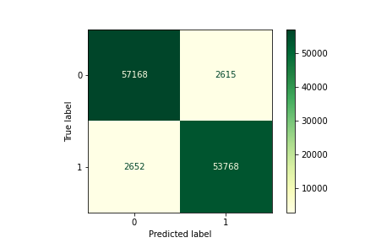
Initial Results
Apprenticeship capstone – tree coverage
Initial Decision Tree Classifier.
Metric
Precision
Recall
Accuracy
F1
95.4%
95.3%
95.5%
95.3%
Result
High metric results for Precision, Recall, Accuracy, and F1
Low number of false positives and false negatives
Next Steps:
Tune Hyperparameters
Notes:
Machine Learning Model: Decision Tree Classifier
Classification Type: Binary Classification
Tools: Python packages and Github
Evaluation metrics: Precision, Recall, Accuracy, F1
Metric Prioritization: It is more important to cut down the correct type of tree while not harming other types of trees, also we do not want to cut down all the Lodgepole Pine trees so if we miss some in the categorization, it wont be as harmful as mis categorizing other types of trees. Therefor, it is more important to have more false negatives than false positives and I will be prioritizing precision over recall.

Slide 13
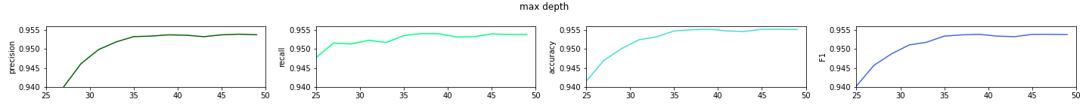
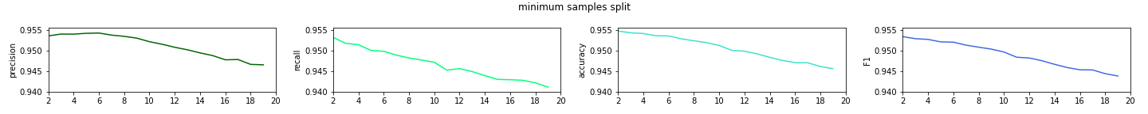
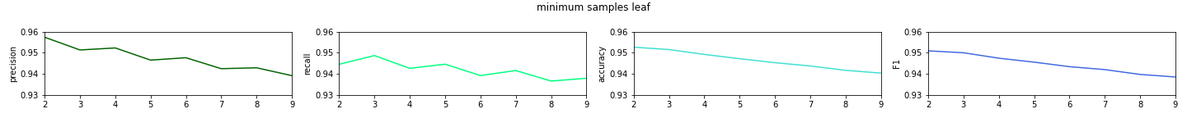
Hyperparameters
Apprenticeship capstone – tree coverage
Initial Decision Tree Classifier.
Max Depth:
Min Samples Split:
Min Samples Leaf:
Notes:
Machine Learning Model: Decision Tree Classifier
Classification Type: Binary Classification
Tools: Python packages and Github
Evaluation metrics: Precision, Recall, Accuracy, F1
Metric Prioritization: It is more important to cut down the correct type of tree while not harming other types of trees, also we do not want to cut down all the Lodgepole Pine trees so if we miss some in the categorization, it wont be as harmful as mis categorizing other types of trees. Therefor, it is more important to have more false negatives than false positives and I will be prioritizing precision over recall.

Slide 14
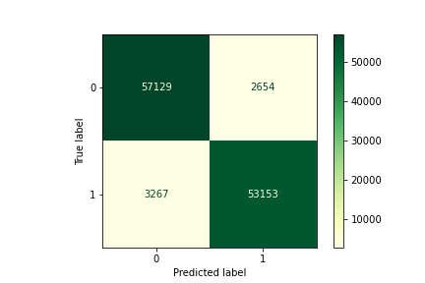
Secondary Results
Apprenticeship capstone – tree coverage
Results after tuning hyperparameters.
Metric
Precision
Recall
Accuracy
F1
95.2%
94.2%
94.9%
94.7%
Result
Similar metric results, but precision is slightly lower
False positives are slightly lower, false negatives are slightly higher
Conclusion:
Use initial model to determine type of tree within Roosevelt National park
Notes:
Machine Learning Model: Decision Tree Classifier
Classification Type: Binary Classification
Tools: Python packages and Github
Evaluation metrics: Precision, Recall, Accuracy, F1
Metric Prioritization: It is more important to cut down the correct type of tree while not harming other types of trees, also we do not want to cut down all the Lodgepole Pine trees so if we miss some in the categorization, it wont be as harmful as mis categorizing other types of trees. Therefor, it is more important to have more false negatives than false positives and I will be prioritizing precision over recall.

Slide 15
Thank you!
Questions?
Notes:
Visual decision tree
Graph of primary metric (pick one to focus on)

